Slide 1




UNIVERSITI TEKNOLOGI MALAYSIA
SECP3623 - DATABASE PROGRAMMING
2025/2026 - SEM 1
Project 2 (5%) - EzTransport, A transport booking system
Name | : | Nurul Ika Syafiny Binti Azhar
Matric Id | : | A23CS0164
Name | : | Lubna Al Haani Binti Radzuan
Matric Id | : | A23CS0107
Name | : | Nuraisyah Binti Mohd Zikre
Matric Id | : | A23CS0160
Name | : | Harini A/P Sangaran
Matric Id | : | A23CS0081

Slide 2



UNIVERSITI TEKNOLOGI MALAYSIA
PROJECT 2 PRESENTATION SLIDE
Transportation Booking System
www.utm.my

Slide 3



INTRODUCTION

Slide 4


This project focuses on a comprehensive transportation booking system inspired by Trip.com platforms. The system will manage the user profile, variety of transportation mode (flights, trains, cars, ferries), booking transactions and payment for the booking made.
Objective
To design and implement a NoSQL backend using MongoDB.
To perform CRUD operation and implement advanced indexing and aggregation pipeline for each team member.
To use the embedded documents and references by applying Document Data Model.
www.utm.my

Slide 5

NoSQL Data Model

Slide 6
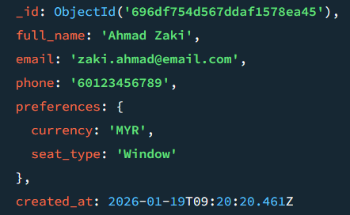
Users Collection
The primary key, _id is a unique ObjectId automatically generated by MongoDB.
Contains fields named full_name, email, phone and created_at
Embedded Document pattern is used to store preferences object, which contains the users’ preferred currency and seat type
www.utm.my

Slide 7
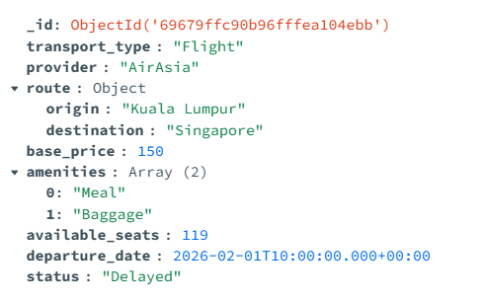
TravelOptions Collection
The primary key, _id is a unique ObjectId automatically generated by MongoDB.
The origin and destination are stored as an Object within the route allowing the system to retrieve all trip details in a single query without needing to join separate tables.
Amenities is an array that stores multiple values in a single list.
www.utm.my

Slide 8
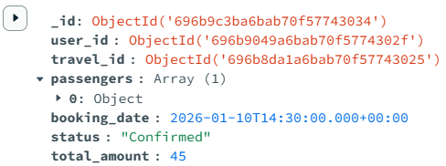
Booking Collection
The primary key (_id) is automatically generated by MongoDB.
The user_id and travel_id fields store the unique identifiers of documents from the Users and TravelOptions collections, respectively where it links travelers to trips.
This collection also uses an Array of Objects for passengers field to store the details of the travelers (name, age, identification) in one document.
www.utm.my

Slide 9
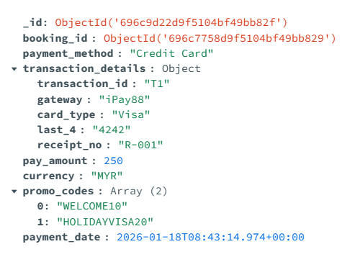
Payment Collection
The primary key, _id is a unique ObjectId automatically generated by MongoDB.
Referencing (booking_id) used to link each payment to each corresponding booking.
An embedded document (transactions_details) used for storage flexibility in storing the payment gateway metadata.
An array (promo_codes) for handling single/multiple promo codes in a single transaction.
Other fields are stored as standard scalar fields (String, Double, and Date) to record the essential financial information.
www.utm.my

Slide 10
NoSQL IMPLEMENTATION
CRUD Operations

Slide 11
NoSQL IMPLEMENTATION
CREATE Operations

Slide 12
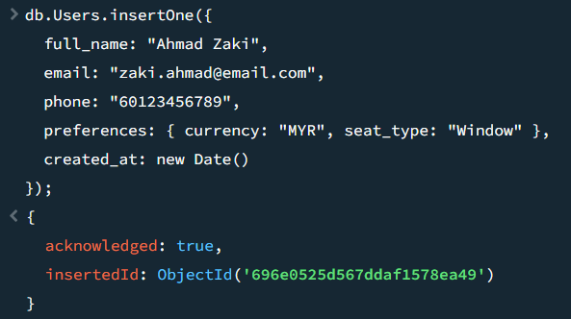
insertOne
insertOne()
Inserts one value in all the fields of a collection.
Example insertion of values in Users collection for a user named Ahmad Zaki.
www.utm.my

Slide 13
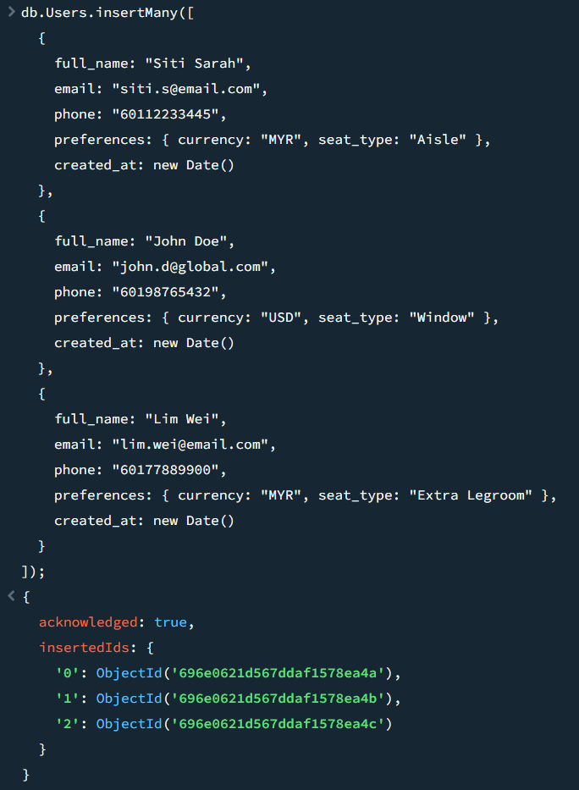
insertMany
insertMany()
Inserts multiple entries in the collection simultaneously.
Example insertion of values in Users collection for users Siti Sarah, John Doe and Lim Wei.
www.utm.my

Slide 14
NoSQL IMPLEMENTATION
READ Operations

Slide 15
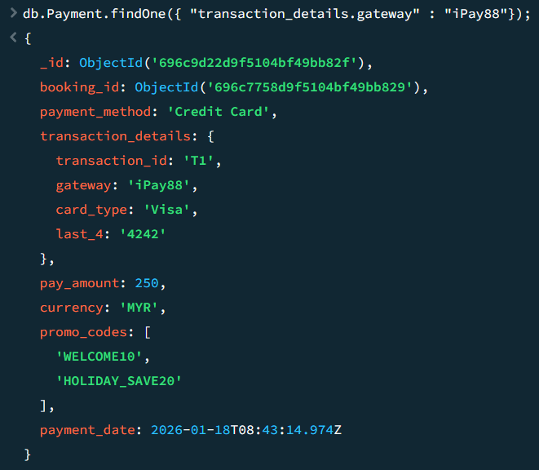
findOne
findOne()
Retrieve a single document that matches a specific criteria which is useful for quick lookups
Example searches for the first document where the transaction_details.gateway is "iPay88".
www.utm.my

Slide 16
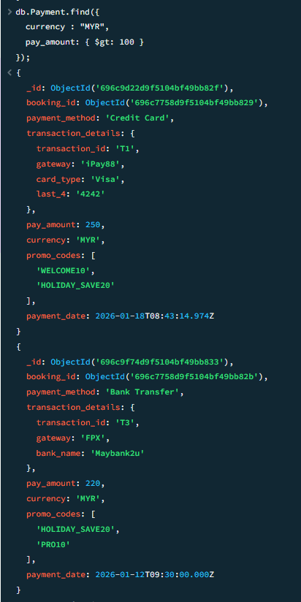
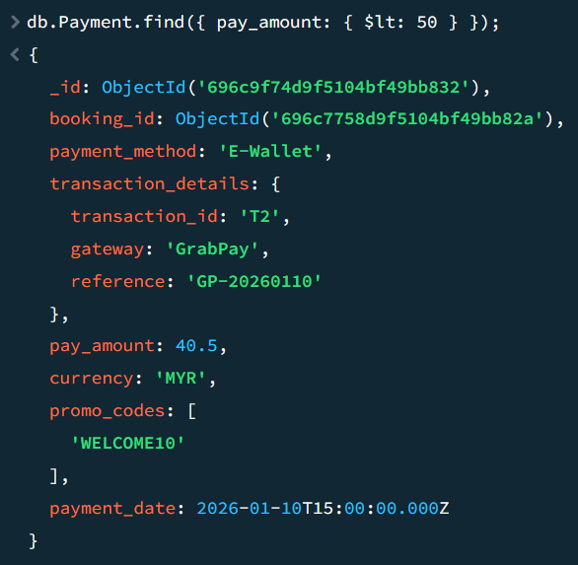
find and condition $gt, $lt
find()
Retrieve all documents that matches a specific criteria.
$gt
It is used for querying documents that is greater than value input
$lt
It is used for querying documents that is less than value input
www.utm.my

Slide 17
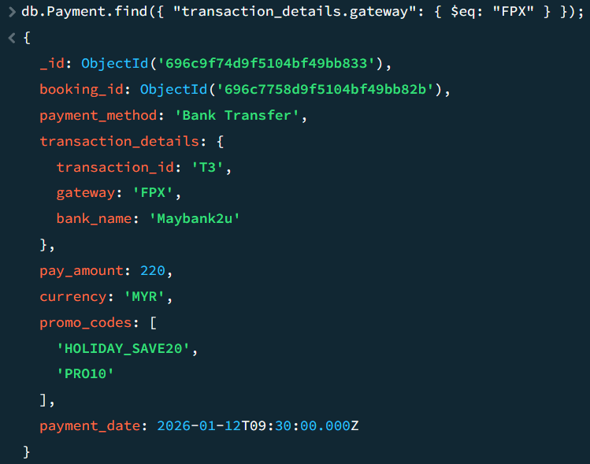
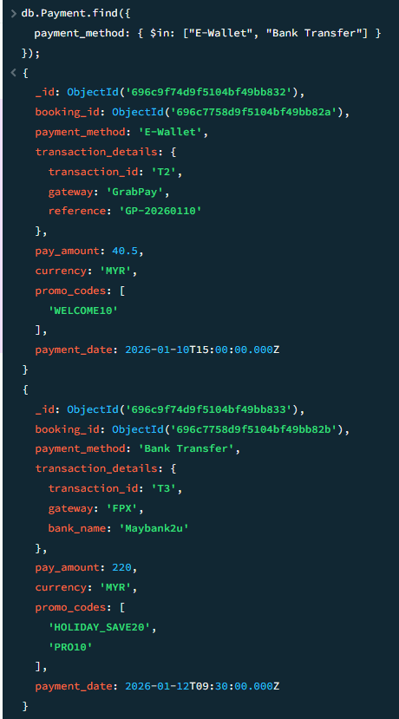
find using $eq, $in
$eq
Used to perform strict equality matches.
Using the $eq operator formally defines the condition.
$in
Used to perform equality matches with multiple values within the same field.
Retrieved documents matches with any values.
www.utm.my

Slide 18
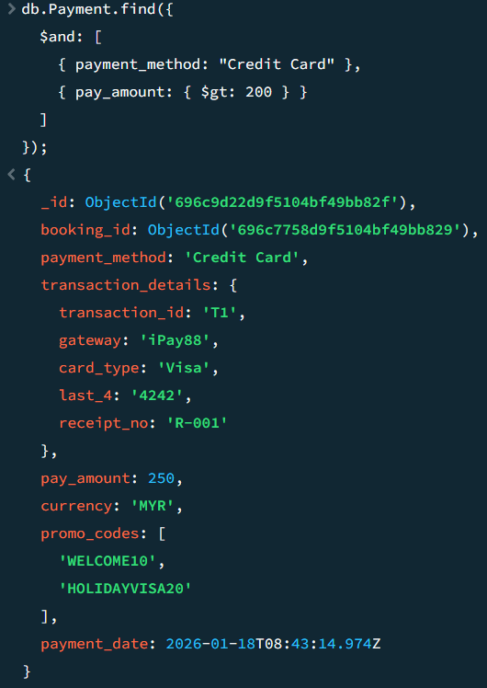
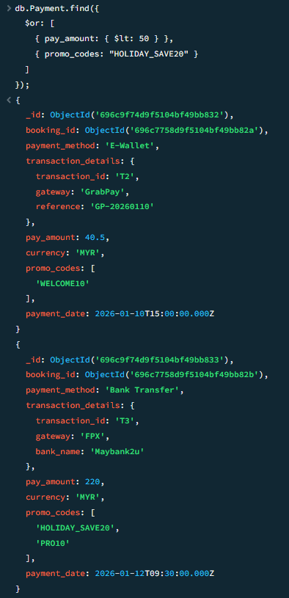
find using $and, $or
$and
Retrieve only documents that satisfy all the listed conditions simultaneously
$or
Retrieve documents that satisfy any of the listed conditions.
www.utm.my

Slide 19
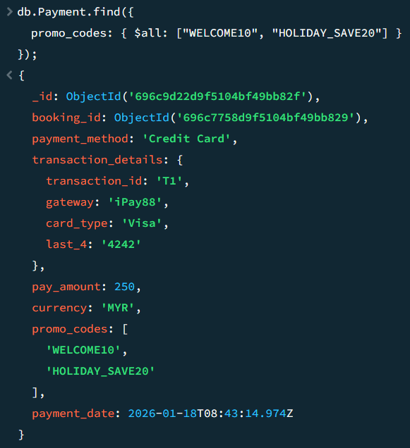
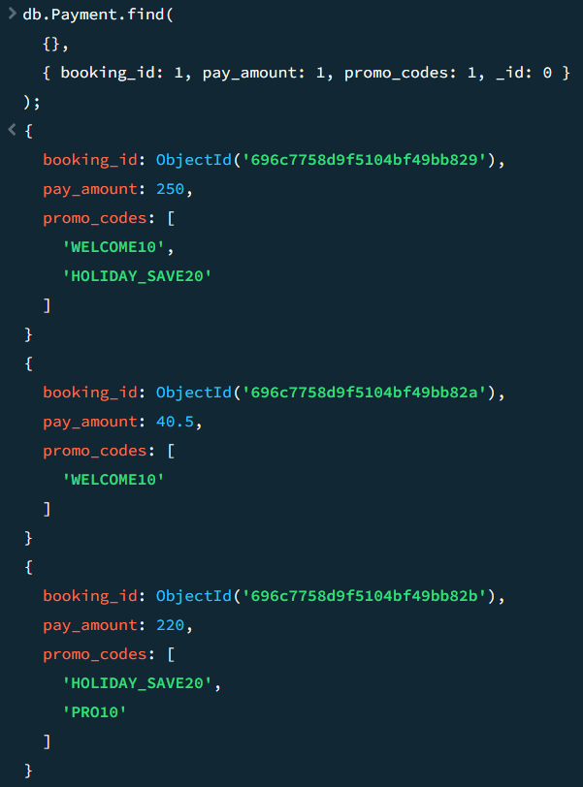
Array and Projection Query
Array Query
Use the $all to retrieve all documents that has the listed array in any order.
Projection
Return only specific data fields required while excluding others.
www.utm.my

Slide 20
NoSQL IMPLEMENTATION
Update Operations

Slide 21
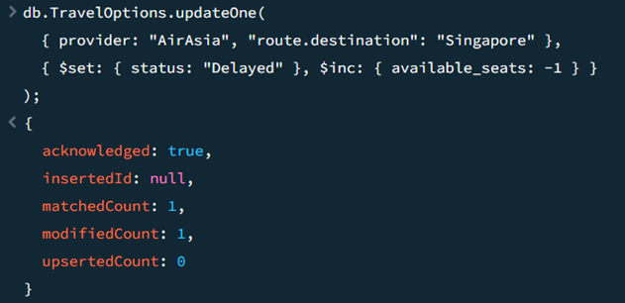
updateOne
The update targets a document where the provider is “AirAsia” and the route.destination is “Singapore”.
The query $set will update its status field to “Delayed”.
Query $inc is used to decrement the available_seats by -1 whenever a booking is confirmed to prevent overbooking.
www.utm.my

Slide 22
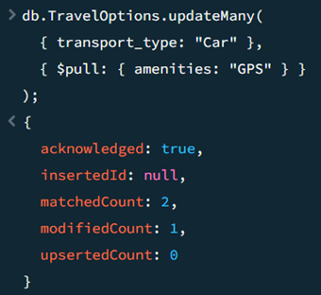
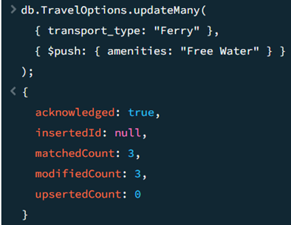
updateMany
$push
The query filters all documents where the transport_type is “Ferry”.
The array operator $push adds the new string “Free Water” into the existing amenities array.
$pull
The filter targets all records categorized as "Car" under the transport_type field.
It uses the $pull operator to remove "GPS" from the amenities array.
www.utm.my

Slide 23
NoSQL IMPLEMENTATION
DELETE Operations

Slide 24
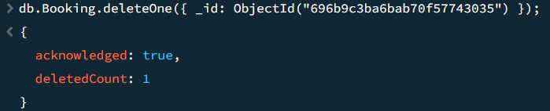
deleteOne
To remove specific record using unique _id ( example: users that cancel booking)
Does not affecting other document in collection.
www.utm.my

Slide 25
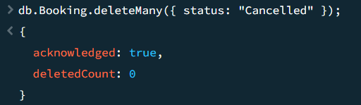
deleteMany
Used for administrative clean-up
Delete the record by filter out the record (“Cancelled”)
Remain optimized
www.utm.my

Slide 26
NoSQL IMPLEMENTATION
Advanced Operations

Slide 27

Indexing
Indexing
Easily locate the specific field instantly.
Creating a separate and sorted data structure to store field value and a pointer to actual document.
Improve query performance to O(log N)
Single Indexing
An index is created on a field where 1 represents ascending or -1 represents descending in sorting order
Compound Indexing
An index is created on multiple fields simultaneously where 1 represents ascending or -1 represents descending in sorting order
www.utm.my

Slide 28
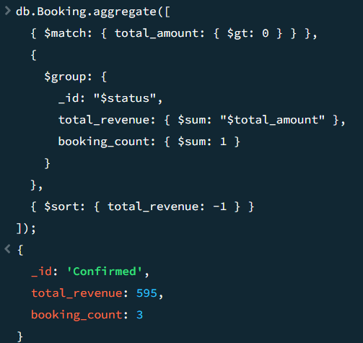
Aggregation
For the aggregation pipeline, used a 3 stages pipeline in Booking collection
First stage:
Use $match operation to filter out the total price that is not greater than zero.
Second stage:
Grouping ($group operation) the booking by status of the booking to find the total price and the number of bookings made.
Third stage:
Use $sort operation to categorize the total price in descending order (-1).
www.utm.my

Slide 29
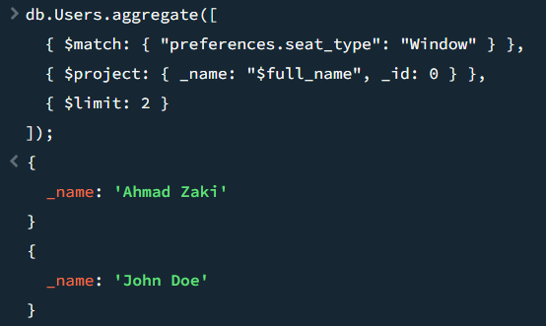
Aggregation
For the aggregation pipeline, used a 3 stages pipeline in Users collection
First stage:
Use $match operation to filter for users who have a specific seat preference, such as "Window"
Second stage:
Use $project operation to control the output display. _id is set to 0 and a new field label, _name, was created to map the existing full_name field.
Third stage:
Use $limit operation to manage the output size which is 2 in this case.
www.utm.my

Slide 30
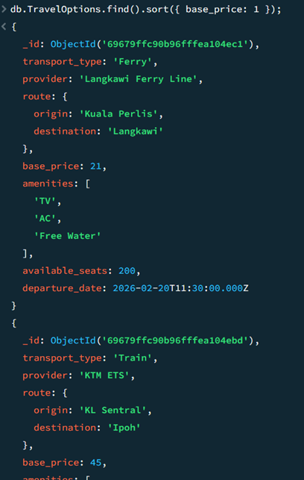
Sort
Ascending
The value 1 indicates Ascending Order which means the documents will be sorted from the cheapest to most expensive.
The output displays the "Langkawi Ferry Line" with a price of 21 as the first result, followed by "KTM ETS" at 45.
This is useful for users looking for cheap travel ways.
www.utm.my

Slide 31
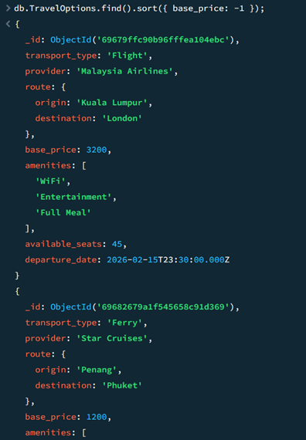
Sort
Descending
The value -1 indicates Descending Order which means the documents will be sorted from the most expensive.
The output shows Malaysia Airlines at the top with a base_price of 3200, followed by Star Cruises at 1200.
This is useful for users looking for high-end or luxury travel experiences, such as international flights or cruise packages.
www.utm.my

Slide 32
TEAM MEMBER CONTRIBUTIONS

Slide 33
Nurul Ika Syafiny Binti Azhar
Design and implementation of the TravelOptions collection.
Authored the NoSQL data model for this collection.
Responsible for populating the collection with diverse sample data representing flights, trains, cars, and ferries to test the system's polymorphic capabilities.
Implemented the CRUD and advanced operations.
www.utm.my

Slide 34
Nuraisyah Binti Mohd Zikre
Design and implementation of the Booking collection.
Authored the NoSQL data model for this collection.
Responsible to links both Users collection and TravelOptions collection by using reference to determine the booking status and the price.
Implemented the CRUD and advanced operations.
www.utm.my

Slide 35
Lubna Al Haani Binti Radzuan
Design and implementation of the Payment collection.
Produced the NoSQL data model for this collection.
Responsible to links Booking collection by using reference to attach the finalized payment information to corresponding booking.
Implemented the CRUD and advanced operations.
Authored the Query Operation and Indexing explanation.
www.utm.my

Slide 36
Harini A/P Sangaran
Design and implementation of the Users collection.
Produced the NoSQL data model for this collection.
Responsible for populating the collection with diverse sample data representing different currencies and preferred seat types.
Implemented the CRUD and advanced operations.
www.utm.my

Slide 37
CONCLUSION

Slide 38
The system successfully combines several travel services such as flights, trains, cars, and ferries into a single polymorphic collection, making cross-platform search and data management easier.
The use of Embedded Documents within the Users and Payments collections ensures that high-frequency data, such as traveler preferences and transaction details, are retrieved with minimal latency, optimizing system performance.
The implementation of Referencing in the Booking collection maintains strict data integrity while preventing redundancy.
The system demonstrates that this NoSQL architecture is scalable and able to meet the real-time, data-intensive demands.
www.utm.my

Slide 39






THANK YOU
utmofficial
univteknologimalaysia
utm.my

